Slide 1
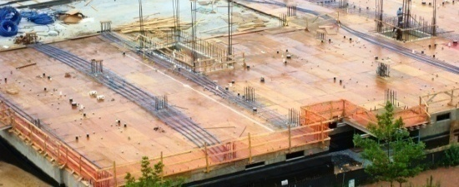
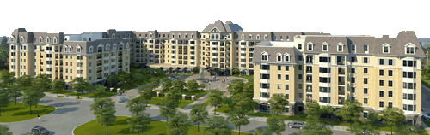
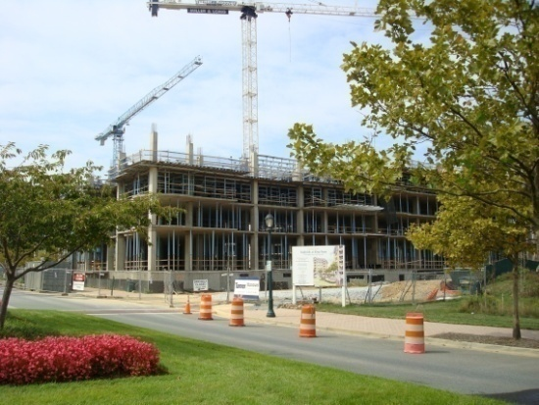
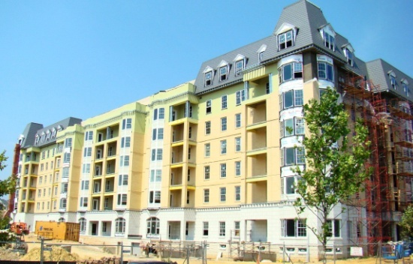
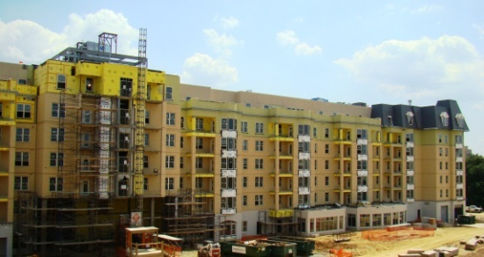
Ingleside AT KING FARM
a
e
STEPHEN A. TAT
An Architectural Engineering Senior Thesis
Structural Option 2008-2009
Introduction
Thesis Statement
Existing Condition
Breadth Study I
Breadth Study II
Structural Depth
Conclusion

Slide 2
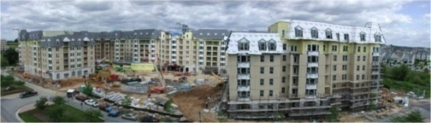
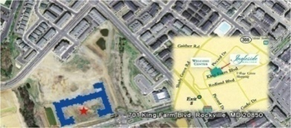
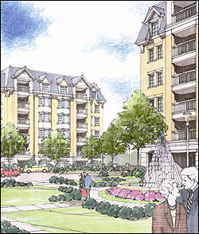
Ingleside AT KING FARM
INTRODUCTION
THESIS STATEMENT
EXISTING CONDITION
BREADTH I
BREADTH II
STRUCTURAL DEPTH
CONCLUSION
a
e
STEPHEN A. TAT
An Architectural Engineering Senior Thesis
Structural Option 2008-2009
Project Team
Owner:
Ingleside Presbyterian Retirement Community
Architect and Landscape Architect:
Cochran, Stephenson & Donkervoet, Inc.
General Contractor:
Turner Construction Company
Construction Manager:
Turner-Konover
Structural Engineer:
Morabito Consultants, Inc.
Introduction
Thesis Statement
Project Profile
Location and Site: 701 King Farm Blvd. Rockville, MD 20852
Building Occupant Name: Elderly Residents and Nurses
Occupancy or function types: CCRC (Continuous Care Retirement Center)
Size: 790,000 SF
Height: 103 feet, 7 above grade, 1 below grade.
Construction Dates: Nov 1, 2006 to Match 2009
Delivery method: CM Agency
Bid Cost: GMP of $97 Million
Existing Condition
Breadth Study I
Breadth Study II
Structural Depth
Conclusion

Slide 3
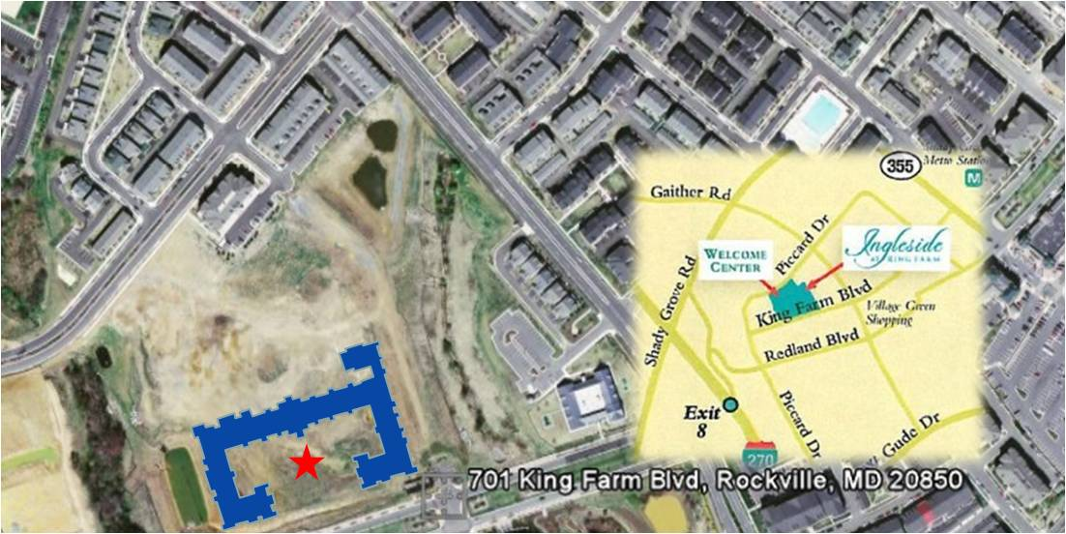
Ingleside AT KING FARM
INTRODUCTION
THESIS STATEMENT
EXISTING CONDITION
BREADTH I
BREADTH II
STRUCTURAL DEPTH
CONCLUSION
a
e
STEPHEN A. TAT
An Architectural Engineering Senior Thesis
Structural Option 2008-2009
Building Usage
The building site is located between a residential and commercial
zone.
The building is continuous care retirement center (CCRC)
Building usage
Rising Demand for CCRC
Introduction
Thesis Statement
Existing Condition
Features: (living units and rec. rooms)
244 Independent living units
43 Assisted living units
16 Skilled nursing units
10 Dementia units
A theater room
A swimming pool
A tennis court
Underground parking
Roof gardens
Breadth Study I
Breadth Study II
Structural Depth
Conclusion

Slide 4
Ingleside AT KING FARM
INTRODUCTION
THESIS STATEMENT
EXISTING CONDITION
BREADTH I
BREADTH II
STRUCTURAL DEPTH
CONCLUSION
a
e
STEPHEN A. TAT
An Architectural Engineering Senior Thesis
Structural Option 2008-2009
Rising Demand for CCRC
Baby Boom generation has just begun to reach retirement age.
According to Future Age magazine March 2009, approximately 78 million baby boomers will reach retirement age.
People aged 50 and over made up 12% of the U.S. population and many (37% in a survey) have desired and demanded a luxurious lifestyle according to Fall 2007 Land Development, National Association of Home Builders.
Boomers have $21 Trillion in spending power according to Money Magazine statistic in 2005.
Over 4,000 CCRCs exists in the U.S. today.
However, the supply of CCRCs falls short of the demand side for the Boomers.
Building usage
Rising Demand for CCRC
Introduction
Thesis Statement
Existing Condition
Breadth Study I
Breadth Study II
Structural Depth
Conclusion

Slide 5
Ingleside AT KING FARM
INTRODUCTION
THESIS STATEMENT
EXISTING CONDITION
BREADTH I
BREADTH II
STRUCTURAL DEPTH
CONCLUSION
a
e
STEPHEN A. TAT
An Architectural Engineering Senior Thesis
Structural Option 2008-2009
Thesis Statement
The demand for CCRCs is increasing faster than the amount of CCRCs being established. Thus, the Ingleside at King Farm CCRC design will be used as a model for a new prototype design on the west coast of the United States.
Reseda Neighborhood (Northridge Earthquake 1994)
Thesis Statement
The 1994 Northridge Earthquake
Introduction
Thesis Statement
Existing Condition
Breadth Study I
Other Goals
Integrate my structural depth with my two breadth studies
Utilizing emerging design principles such as green built
Design of an alternative building envelope to adapt to the region’s climate
Breadth Study II
Structural Depth
LA
Conclusion
Relocation on the West Coast
Los Angeles, California
Site conditions will affect breadth studies and structural depth

Slide 6
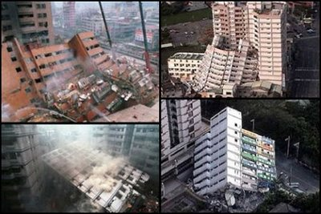
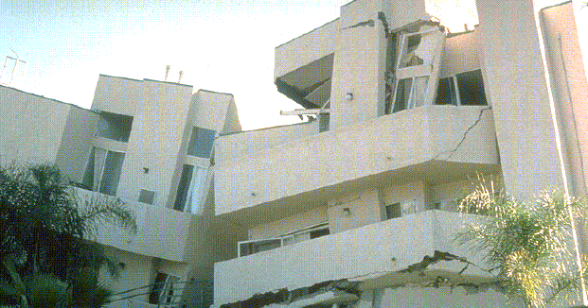
Ingleside AT KING FARM
INTRODUCTION
THESIS STATEMENT
EXISTING CONDITION
BREADTH I
BREADTH II
STRUCTURAL DEPTH
CONCLUSION
a
e
STEPHEN A. TAT
An Architectural Engineering Senior Thesis
Structural Option 2008-2009
The 1994 Northridge Earthquake
Occurred on Jan. 17, 1994
Lasting for about 20 seconds
Moment magnitude of 6.7
$20 billion in damage
Blind thrust faults: exist near tectonic plate margins, in the broad disturbance zone. They form when a section of the earth's crust is under high compressive stresses, due to plate margin collision, or the general geometry of how the plates are sliding past each other.
Although usually of magnitude 6 to 7 compared to the largest magnitude 9 earthquakes of recent times, it was especially destructive because the seismic waves are highly directed, and the soft basin soil of the valley can amplify the ground motions tenfold or more
Thesis Statement
The 1994 Northridge Earthquake
Introduction
Thesis Statement
Existing Condition
Breadth Study I
Breadth Study II
Structural Depth
Conclusion

Slide 7
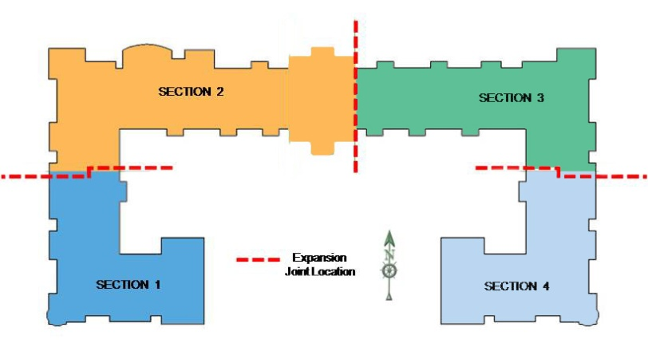
Ingleside AT KING FARM
INTRODUCTION
THESIS STATEMENT
EXISTING CONDITION
BREADTH I
BREADTH II
STRUCTURAL DEPTH
CONCLUSION
a
e
STEPHEN A. TAT
An Architectural Engineering Senior Thesis
Structural Option 2008-2009
Expansion Joints
There are three true 2-inch expansion joints built into the building.
To reduce pre-stress losses in the tendons due to the shortening of the concrete slab caused by shrinkage or cooling, which will induce cracks around restraining boundaries (such as walls and beams)..
Another reason is for better constructability and the utilization time for faster construction.
Where there exist a 2” true expansion joint in the building, there is a row of double 12” x 30” columns as oppose to the typical 24” x 30” columns on each side of the joint.
Building Sections Created by Expansion Joints
Typ. Floor Exp. Joint Detail
Expansion Joints
Two-way Post-tension Flat Plate System
Gravity System
Shear Walls
Foundations
Introduction
Thesis Statement
Existing Condition
Breadth Study I
Breadth Study II
Structural Depth
Conclusion
12” x 30”
Columns
Expansion Joints

Slide 8
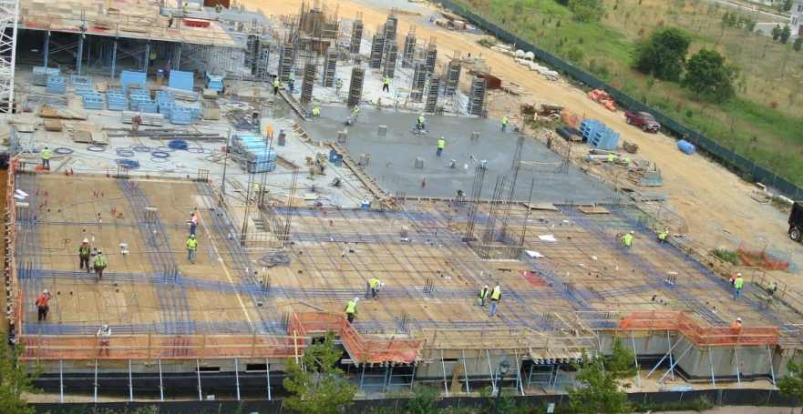
Ingleside AT KING FARM
INTRODUCTION
THESIS STATEMENT
EXISTING CONDITION
BREADTH I
BREADTH II
STRUCTURAL DEPTH
CONCLUSION
a
e
STEPHEN A. TAT
An Architectural Engineering Senior Thesis
Structural Option 2008-2009
Two-way Post-tension Flat Plate System
270 ksi unbonded ½ diameter 7 wire tendons.
Concrete slabs are 8 inches thick for typical floors with a compressive strength of 4500 psi.
Irregular column gird of the building
Bays range from 15 feet to 29.5 feet.
Expansion Joints
Two-way Post-tension Flat Plate System
Gravity System
Shear Walls
Foundations
Introduction
Thesis Statement
Existing Condition
Breadth Study I
Breadth Study II
Structural Depth
Typical Tendon Support Bars
Conclusion

Slide 9
Ingleside AT KING FARM
INTRODUCTION
THESIS STATEMENT
EXISTING CONDITION
BREADTH I
BREADTH II
STRUCTURAL DEPTH
CONCLUSION
a
e
STEPHEN A. TAT
An Architectural Engineering Senior Thesis
Structural Option 2008-2009
Gravity System
Over 140 reinforced columns, are either 18” x 30” or 12” x 30”.
Expansion Joints
Two-way Post-tension Flat Plate System
Gravity System
Shear Walls
Foundations
Introduction
Thesis Statement
Shear Walls
Seven of the walls are ordinary reinforced concrete shear walls located at stairwells and elevator shafts with #4 horizontal reinforcing bars and #8 vertical reinforcing bars. Typical spacing of these bars is 12 inches.
The remaining four reinforced concrete shear walls have boundary elements and are 15 feet in length; two in east/west direction and two in north/south direction. Spacing of vertical and horizontal reinforcements is 30 inches and 12 inches respectively. Typical clear cover is 1 ½ inches for the reinforcements.
Existing Condition
Breadth Study I
Breadth Study II
Structural Depth
Conclusion

Slide 10
Ingleside AT KING FARM
INTRODUCTION
THESIS STATEMENT
EXISTING CONDITION
BREADTH I
BREADTH II
STRUCTURAL DEPTH
CONCLUSION
a
e
STEPHEN A. TAT
An Architectural Engineering Senior Thesis
Structural Option 2008-2009
Foundations
The loads from above are transferred down by 30” x 18” reinforced concrete columns with 10 #8 bars to spread footings of various sizes.
Beneath the spread footings is 3 feet of compact fill and soil with a bearing capacity of 50 ksf.
The structural slab in the foundation and sub level parking garage is a 5” concrete slab on grade reinforced with 6” x 6” W2.9 / W2.9 welded wire fabric over a vapor barrier and a 4” porous fill. It utilizes standard weight concrete with a 28 day minimum compressive strength of 4000 psi.
40% of the footings are sized 10’- 6” x 10’- 6” x 30” with 10 # 8 E. W. reinforcing bars at the bottom;
20% of the footings are sized 12’ x 12’ x 34” with 10 # 9 E. W. reinforcing bars at the bottom;
All shear walls are designed with much larger spread footings typically 20’ x 28’ x 30” with 22 # 9 S.W. and 16 # 9 L.W. top and bottom.
Expansion Joints
Two-way Post-tension Flat Plate System
Gravity System
Shear Walls
Foundations
Introduction
Thesis Statement
Existing Condition
Breadth Study I
Breadth Study II
Structural Depth
Conclusion

Slide 11
Ingleside AT KING FARM
INTRODUCTION
THESIS STATEMENT
EXISTING CONDITION
BREADTH I
BREADTH II
STRUCTURAL DEPTH
CONCLUSION
a
e
STEPHEN A. TAT
An Architectural Engineering Senior Thesis
Structural Option 2008-2009
Breadth 1: Green Roof
Executive Order S-20-04:
Green Building Initiative reducing the energy consumption.
Environmental benefits:
Enhance and protect ecosystems and biodiversity
Improve air and water quality
Reduce solid waste
Conserve natural resources
Economic benefits:
Reduce operating costs
Enhance asset value and profits
Improve employee productivity and satisfaction
Optimize life-cycle economic performance
Health and community benefits:
Improve air, thermal, and acoustic environments
Enhance occupant comfort and health
Minimize strain on local infrastructure
Contribute to overall quality of life
Comparison of Extension and Intensive Green Roof Systems
 | EXTENSIVE GREEN ROOF | INTENSIVE GREEN ROOF
 | Thin growing medium; little or no irrigation; stressful conditions for plants; low plant diversity | Deep soil; irrigation system; more favorable conditions for plants; high plant diversity; often accessible
Advantages
Existing Roof Membrane: White PVC Single Ply System
Placement of Green Roof on Prototype Design
Green Design – Green Roof
Green Façade Material
Building Envelope
Introduction
Thesis Statement
• Lightweight; roof generally does
not require reinforcement.
• Suitable for large areas.
• Dutiable for roofs with 0 - 30°
(slope).
• Low maintenance and long life.
• Often no need for irrigation and
specialized drainage systems.
• Less technical expertise needed.
• Often suitable for retrofit projects.
• Can leave vegetation to grow
spontaneously.
• Relatively inexpensive.
• Looks more natural.
• Easier for planning authority to
demand as a condition of planning
approvals.
• Greater diversity of plants and
habitats.
• Good insulation properties.
• Can simulate a wildlife garden
on the ground.
• Can be made very attractive
visually.
• Often accessible, with more
diverse utilization of the roof.
i.e. for recreation, growing food,
as open space.
• More energy efficiency and
storm water retention capability.
• Longer membrane life.
Existing Condition
Breadth Study I
Breadth Study II
Structural Depth
Conclusion

Slide 12
Ingleside AT KING FARM
INTRODUCTION
THESIS STATEMENT
EXISTING CONDITION
BREADTH I
BREADTH II
STRUCTURAL DEPTH
CONCLUSION
a
e
STEPHEN A. TAT
An Architectural Engineering Senior Thesis
Structural Option 2008-2009
Breadth 1: Green Roof
Green Design – Green Roof
Green Façade Material
Building Envelope
Introduction
Thesis Statement
Existing Condition
Breadth Study I
Breadth Study II
Structural Depth
Conclusion

Slide 13
Ingleside AT KING FARM
INTRODUCTION
THESIS STATEMENT
EXISTING CONDITION
BREADTH I
BREADTH II
STRUCTURAL DEPTH
CONCLUSION
a
e
STEPHEN A. TAT
An Architectural Engineering Senior Thesis
Structural Option 2008-2009
Breadth 1: Green Roof
Irrigation
If all of the rain water were captured, it would supply 70 percent of the estimated annual water needs of the roof (EAD, Los Angeles, CA).
Summary of Costs
The benefits provided by a green roof depends on many factors. The direct benefits that can result from a green roof, such as the decreased cooling expenses is just one of many. Taking into consideration the many benefits provided by green roofs undoubtedly would yield a much higher total value. Such as the energy savings and improved air quality to have a present value (assuming a 20 year project life) of approximately $0.72 per square foot of cool roof (EAD, Los Angeles, CA).
Life Cycle Cost Analysis
Initial Cost
The costs of green roofs have declined, and the GAP green roof would probably only cost $11 to $14 per square foot ($120 to $150/sq m) today (EAD, Los Angeles, CA).
Maintenance
A green roof does have higher maintenance costs than a conventional roof. Maintenance activities that must be performed on a green roof are weeding, replanting, and inspections of the waterproof membrane. The green roof can also be divided into distinct compartments which can be moved for inspections or, when the time comes, after 30 to 50 years, for the replacement of the membrane. Electronic leak detection services are also available. Conducting several annual plant inspections and an annual inspection of the roof membrane entails an annual expense of approximately $1 per square foot.
Green Design – Green Roof
Green Façade Material
Building Envelope
Introduction
Thesis Statement
Existing Condition
Breadth Study I
Breadth Study II
Structural Depth
Conclusion

Slide 14
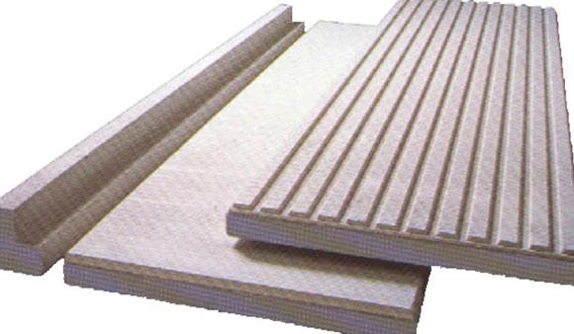
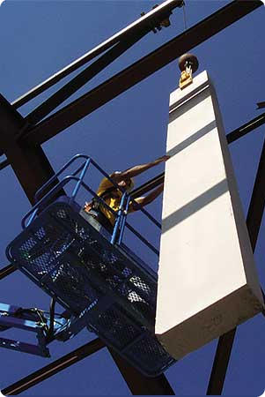
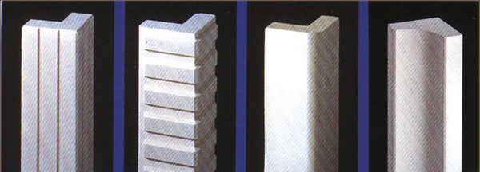
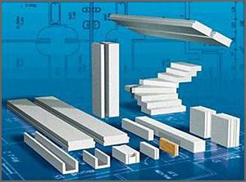
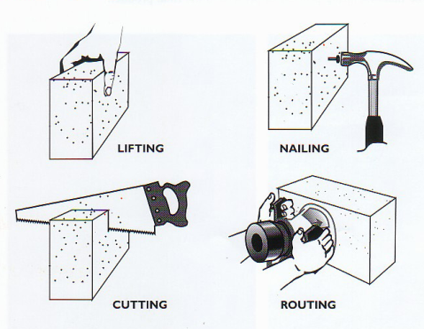
Ingleside AT KING FARM
INTRODUCTION
THESIS STATEMENT
EXISTING CONDITION
BREADTH I
BREADTH II
STRUCTURAL DEPTH
CONCLUSION
a
e
STEPHEN A. TAT
An Architectural Engineering Senior Thesis
Structural Option 2008-2009
Breadth 1: Green Façade Material
Use AUTOCLAVED AERATED CONCRETE (AAC) - green material
Seismic design
The light weight of AAC in relation to its strength reduces the base shear.
Fire-resistant characteristics provide further advantage against fires commonly associated with earthquakes. (4” thick panel gives UL fire rating of 4 hours)
Building Envelope Benefits
High durability = less maintenance, good life cycle cost
Rapid construction and good workability = reduced labor
Excellent thermal insulation
Excellent sound absorption
Lighter than light weight concrete (~80% air)
Green Design – Green Roof
Green Façade Material
Building Envelope
Introduction
Thesis Statement
Existing Condition
Breadth Study I
Breadth Study II
Structural Depth
Conclusion

Slide 15
Ingleside AT KING FARM
INTRODUCTION
THESIS STATEMENT
EXISTING CONDITION
BREADTH I
BREADTH II
STRUCTURAL DEPTH
CONCLUSION
a
e
STEPHEN A. TAT
An Architectural Engineering Senior Thesis
Structural Option 2008-2009
Breadth 1: Green Façade Material
How is it made?
Green Design – Green Roof
Green Façade Material
Building Envelope
Introduction
Ingredients used to make AAC include Portland cement mixed with lime, silica sand, or recycled fly ash (a byproduct from coal-burning power plants), water, and aluminum powder or paste and the mixed is poured into a mold.
The reaction between aluminum and concrete causes microscopic hydrogen bubbles to form, expanding the concrete to about five times its original volume. After evaporation of the hydrogen, the now highly closed-cell, aerated concrete is cut to size and formed by steam-curing in a pressurized chamber (an autoclave). The result is a non-organic, non-toxic, airtight material.
Panels are available in thicknesses of between 8 inches to 12 inches, 24-inches in width, and lengths up to 20 feet.
Blocks come 24”, 32”, and 48” inches long, between four to 16 inches thick, and eight inches high.
Thesis Statement
Existing Condition
Breadth Study I
Breadth Study II
Structural Depth
Conclusion

Slide 16
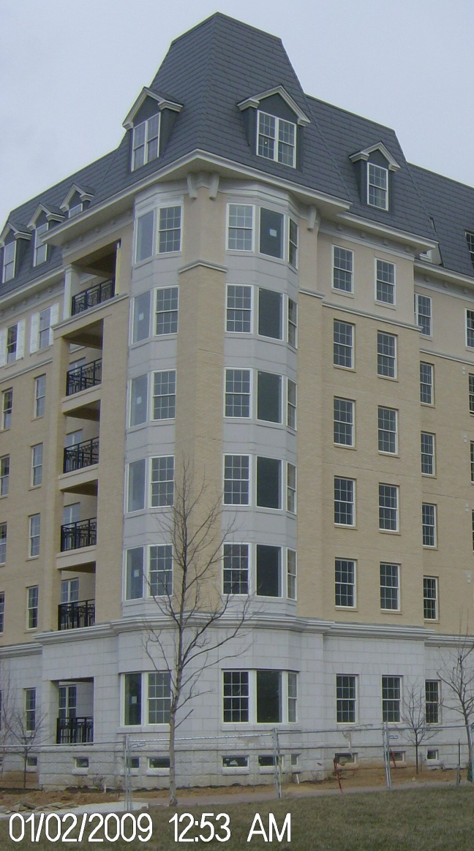
Ingleside AT KING FARM
INTRODUCTION
THESIS STATEMENT
EXISTING CONDITION
BREADTH I
BREADTH II
STRUCTURAL DEPTH
CONCLUSION
a
e
STEPHEN A. TAT
An Architectural Engineering Senior Thesis
Structural Option 2008-2009
Building Envelope:
The roof membrane is a 3” rigid insulation on 1 ½” x 20 gauge galvanized metal deck supported by either 26 k12 or 28 k12 joists depending on the roof loads with an assembly consisting of 8” post tension slab and membrane roof water proofing system.
The 7th floor building envelope consist of a sloped roof assemble (mansard roof style) characterized by dark colored metal shingles on plywood roof sheathing and 4" metal stud framing.
On the 6th floor, the exterior veneer brick is replaced by a light-beige stucco with a reinforcing mesh behind it.
The mid section of the building (2nd to 5th floor) is similar to the base section except that masonry brick is used in place of the cast stones.
The base consist of 16x24 cast stones. It is followed by an air space, ½” sheathing, masonry veneer ties at 16” O.C., 6” steel studs at 16” O.C., 6” batt insulation at an R value of 19 and 5/8” foil face gypsum board.
Green Design – Green Roof
Green Façade Material
Building Envelope
Introduction
Thesis Statement
Existing Condition
Breadth Study I
Breadth Study II
Structural Depth
Conclusion

Slide 17
Ingleside AT KING FARM
INTRODUCTION
THESIS STATEMENT
EXISTING CONDITION
BREADTH I
BREADTH II
STRUCTURAL DEPTH
CONCLUSION
a
e
STEPHEN A. TAT
An Architectural Engineering Senior Thesis
Structural Option 2008-2009
Breadth 2: Building Envelope Redesign
Use light weight precast architectural panels to reduce building weight, which in turn reduce the base shear of the building, but still conserve the aesthetics of the original cavity wall design..
Address structural integrity and code compliances such as cladding issues and strength issues.
Analyze air and moisture permeability, and thermal comfort provided by the recommended envelope assembly.
Building Envelope Redesign
Building Envelope Analysis
Introduction
Thesis Statement
Existing Condition
Breadth Study I
Deflection
The allowable lateral deflection
of AERCON wall panels due to
lateral load is L/240. In most cases, an 6" thick wall panel is sufficient to resist the design loads in L.A. as wind is not a factor (85 mph per ASCE-07)
Breadth Study II
Structural Depth
Conclusion
6”

Slide 18
Ingleside AT KING FARM
INTRODUCTION
THESIS STATEMENT
EXISTING CONDITION
BREADTH I
BREADTH II
STRUCTURAL DEPTH
CONCLUSION
a
e
STEPHEN A. TAT
An Architectural Engineering Senior Thesis
Structural Option 2008-2009
Breadth 2: Building Envelope Redesign
The following cavity wall assembly was designed for the prototype:
Exterior Autoclaved Aerated Concrete Panels - 6.0 inch thick
Air space and drainage plane - 2.5 inch
Paper stand - 8 mil
Plywood sheathing ½ inch
Rigid insulation - 2 inch
Steel Studs -5 ½ inch
And gypsum board - ½ inch
The material is available in masonry units and precast panels. The usage of a single material with various appearance can reduce the amount of façade interfaces that is in the existing design of Ingleside at King Farm. This will decrease the chances of infiltration and moisture penetration into the structure and conditioned spaces.
Building Envelope Redesign
Building Envelope Analysis
Introduction
Thesis Statement
Existing Condition
Breadth Study I
Breadth Study II
Structural Depth
Conclusion

Slide 19
Ingleside AT KING FARM
INTRODUCTION
THESIS STATEMENT
EXISTING CONDITION
BREADTH I
BREADTH II
STRUCTURAL DEPTH
CONCLUSION
a
e
STEPHEN A. TAT
An Architectural Engineering Senior Thesis
Structural Option 2008-2009
Breadth 2: Building Envelope Analysis
Building Envelope Redesign
Building Envelope Analysis
Introduction
Thesis Statement
Existing Condition
Breadth Study I
Breadth Study II
Structural Depth
AAC panel, 6 in. 6.00
cavity , 2.5 in. 2.50
AAC panel, 6 in. 6.00
cavity , 2.5 in. 2.50
Conclusion

Slide 20
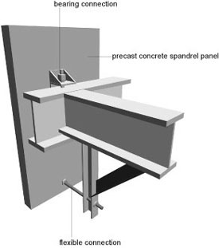
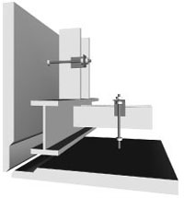
Ingleside AT KING FARM
INTRODUCTION
THESIS STATEMENT
EXISTING CONDITION
BREADTH I
BREADTH II
STRUCTURAL DEPTH
CONCLUSION
a
e
STEPHEN A. TAT
An Architectural Engineering Senior Thesis
Structural Option 2008-2009
Breadth 2: Building Envelope Redesign
Building Envelope Redesign
Building Envelope Analysis
Introduction
The most common moisture protection system used with precast concrete wall systems is a barrier system incorporating an adequate joint seal. In some cases where additional moisture protection is needed, the application of a sealer or a concrete coating is also used
Thesis Statement
Existing Condition
Breadth Study I
Breadth Study II
Structural Depth
Conclusion
Seismic codes require that heavy panels accommodate movement either by sliding or ductile connections. In high seismic zones a ductile connection will be utilized in the prototype design of Ingleside at King Farm. One type of ductile connection is a "Push-pull“ - with Bearing connection at top, tieback connection at bottom.

Slide 21
Ingleside AT KING FARM
INTRODUCTION
THESIS STATEMENT
EXISTING CONDITION
BREADTH I
BREADTH II
STRUCTURAL DEPTH
CONCLUSION
a
e
STEPHEN A. TAT
An Architectural Engineering Senior Thesis
Structural Option 2008-2009
Goals and Criteria
Goals:
Utilize a steel structural system
Preserve existing architectural design (Plans, story heights, aesthetics)
Optimize lateral system
Codes and Standards:
Meet seismic design criteria
Strength design
Serviceability requirements
State/local codes (LOS ANGELES REGIONAL UNIFORM CODE PROGRAM
(LARUCP))
Codes, Standards, and Guides
Codes and Standards in Original Design | Codes and Standards used for Prototype Design
International Building Code 2003 | International Building Code 2006
ASCE 7-98: Minimum Design Loads For Buildings and other Structures. | ASCE 7-05: Minimum Design Loads For Buildings and other Structures.
Rockville, MD City Codes: Local amendments. | American Institute of Steel Construction (AISC) 13th Edition
 | AISC Seismic Design Manual
 | AISC –LRFD 1999, Load and Resistance Factor Design Specification for Structural Steel Buildings
 | Vulcraft Steel Roof and Deck Catalog
 | 2007 California Building Code Section 1614
 | ACI 318-08 Building Code Requirements for Structural Concrete
 | PCI Design Handbook - Precast and Prestressed Concrete
 | Architectural Precast Concrete (2nd ed.)
 | IBC 2006 Structural/Seismic Design Manual: Building Design Examples for Steel and Concrete.
Goals and Criteria
Placement of Expansion Joints
Expansion Joints Specified by Code
Floor System Design
Lateral Design
Seismic Analysis
Load Combinations:
All are based on LRFD design method
∗ 1.4(D + F)
∗ 1.2(D + F + T) + 1.6(L + H) + 0.5(Lr or S
or R)
∗ 1.2D + 1.6(Lr or S or R) + (L or 0.8W)
∗ 1.2D + 1.6W + L + 0.5(Lr or S or R)
∗ 1.2D + 1.0E + L + 0.2S
∗ 0.9D + 1.6W + 1.6H
∗ 0.9D + 1.0E + 1.6H
Introduction
Thesis Statement
Existing Condition
Breadth Study I
Breadth Study II
Structural Depth
Conclusion

Slide 22
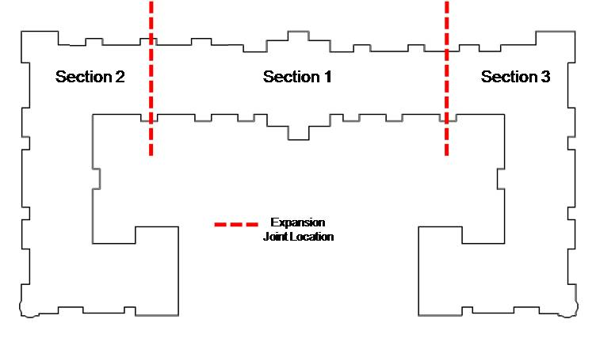
Ingleside AT KING FARM
INTRODUCTION
THESIS STATEMENT
EXISTING CONDITION
BREADTH I
BREADTH II
STRUCTURAL DEPTH
CONCLUSION
a
e
STEPHEN A. TAT
An Architectural Engineering Senior Thesis
Structural Option 2008-2009
Placement of Expansion Joints
In Existing Structure
Goals and Criteria
Placement of Expansion Joints
Expansion Joints Specified by Code
Floor System Design
Lateral Design
Seismic Analysis
The relocation of expansion joints is needed due to the irregular configuration of the building. Two main problems related to seismic performance that may result are:
Different vibrations between different wings may result in a local stress concentration at reentrant corners.
Torsion may result because of the center of rigidity and center of mass not coinciding.
Re align the column grid for more consistency in bays
Introduction
135’
148’
Thesis Statement
Existing Condition
66’
Breadth Study I
Breadth Study II
281’
Structural Depth
Conclusion
90’
136’

Slide 23
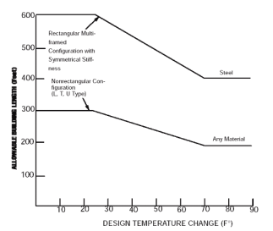
Ingleside AT KING FARM
INTRODUCTION
THESIS STATEMENT
EXISTING CONDITION
BREADTH I
BREADTH II
STRUCTURAL DEPTH
CONCLUSION
a
e
STEPHEN A. TAT
An Architectural Engineering Senior Thesis
Structural Option 2008-2009
Expansion Joints Specified by Code
As for normal temperature change, the average daily change is approximately 20° F. According to a graph in the AISC Steel Construction Manual, the allowable building length for a steel constructed building is approximately 450 feet for a temperature change of 60 ° F. The max distance of a building section as a result of my proposed expansion joint placements is no greater than 281 feet. This meets the design length criteria.
As for minimum building separation (of adjoining structures), L.A , California had modified ASCE 7 in Section 1614 in the 2007 California Building Code to allow for the maximum inelastic response displacement :
ΔM = C_{d} δ_{max} (equation 16-45).
Where δ_{max} is the calculated maximum displacement at Level x as define in ASCE 7
Section 12.8.4.3.
Goals and Criteria
Placement of Expansion Joints
Expansion Joints Specified by Code
Floor System Design
Lateral Design
Seismic Analysis
Introduction
Thesis Statement
ASCE 7-05 Minimum Design Loads for Buildings and Other Structures states, “Dimensional changes in a structure and its elements due to variations in temperature, relative humidity, or other effects shall not impair the serviceability of the structure.”
Existing Condition
450 feet
Breadth Study I
Breadth Study II
Structural Depth
Conclusion

Slide 24
Ingleside AT KING FARM
INTRODUCTION
THESIS STATEMENT
EXISTING CONDITION
BREADTH I
BREADTH II
STRUCTURAL DEPTH
CONCLUSION
a
e
STEPHEN A. TAT
An Architectural Engineering Senior Thesis
Structural Option 2008-2009
Floor System Design
Composite Beam and Formed Metal Deck
Slab Design
Use 18 gauge 3 inch formed deck | Slab depth = 6.25"
fy=50ksi | Light Weight Conc: f'c=3 ksi
Max unshored span = 10.7 ft
Required Moment for Composite Beam
Mu=1.2 (65.3) + 1.6 (112) = 258 ft kips | W 18 x 40 or W 16 x 31
Required Strength for bare steel beam under dead load plus construction live
Mu=1.2(65.3) + 1.6(40) = 142 ft kip
Mp = 203 ft kip > 142 ft kip | W16x31 is ok for beam
Serviceability Criteria
Live Load Deflection | L/360
Total Deflection Limit | L/240
Construction Load Deflection | L/360
Section 1 (Bay under Public Loads)
Goals and Criteria
Placement of Expansion Joints
Expansion Joints Specified by Code
Floor System Design
Lateral Design
Seismic Analysis
Typical Floor System Loads
 |  |  | Spaces |  | Façade
 |  |  | Residential | Public
Load Type | Material / Usage | Reference | Load | Load | Load
Dead Load | Light Weight Concrete | ACI 318 - 08 | 110 pcf (30 psf - 3.25" above flute) |  | -
 | Steel Deck | ASCE 7 - 05 | 3 psf |  | -
 | Partition Walls | WDG | 15 psf |  | -
 | Miscellaneous (M/E/P) | ASCE 7 - 05 | 10 psf |  | -
 | Cold-formed, light gauge steel stud walls with insulation and 5/8" gypsum board | WDG | - | - | 5 psf
 | 6" Precast Concrete Panels (Autoclaved Aerated Concrete - AAC) | MSJC | - | - | 34 pcf
Live Load | Corridors/Theater/or Retail Spaces | ASCE 7 - 05 | - | 100 psf | -
 | Living Units | ASCE 7 - 05 | 40 psf | - | -
Introduction
Thesis Statement
Existing Condition
Breadth Study I
30’
Breadth Study II
W 18 x 55
Structural Depth
Conclusion
30’
W 16 x 31
W 18 x 55
W 16 x 31
30’
W 18 x 55
W 18 x 55

Slide 25
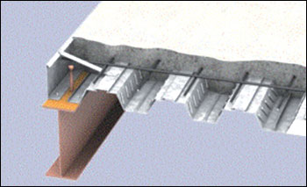
Ingleside AT KING FARM
INTRODUCTION
THESIS STATEMENT
EXISTING CONDITION
BREADTH I
BREADTH II
STRUCTURAL DEPTH
CONCLUSION
a
e
STEPHEN A. TAT
An Architectural Engineering Senior Thesis
Structural Option 2008-2009
Structural Depth
From AISC Steel Design Guide: Low-and Medium-Rise Steel Buildings
Goals and Criteria
Placement of Expansion Joints
Expansion Joints Specified by Code
Floor System Design
Lateral Design
Seismic Analysis
Introduction
Thesis Statement
Existing Condition
Breadth Study I
Breadth Study II
Structural Depth
Conclusion

Slide 26
Ingleside AT KING FARM
INTRODUCTION
THESIS STATEMENT
EXISTING CONDITION
BREADTH I
BREADTH II
STRUCTURAL DEPTH
CONCLUSION
a
e
STEPHEN A. TAT
An Architectural Engineering Senior Thesis
Structural Option 2008-2009
Structural Depth
Members Sized in RAM
Girders: W 18 x 40
Infill Beams: W 16x26, W 16 x 31
Beams supporting façade: W 8 x 10, W 14 x 22
Goals and Criteria
Placement of Expansion Joints
Expansion Joints Specified by Code
Floor System Design
Lateral Design
Seismic Analysis
Introduction
Thesis Statement
Existing Condition
Breadth Study I
Breadth Study II
Structural Depth
Conclusion

Slide 27
Ingleside AT KING FARM
INTRODUCTION
THESIS STATEMENT
EXISTING CONDITION
BREADTH I
BREADTH II
STRUCTURAL DEPTH
CONCLUSION
a
e
STEPHEN A. TAT
An Architectural Engineering Senior Thesis
Structural Option 2008-2009
Floor System Design
Column Members Sized
Typically W 14 x 43 and W 14 x 90
Goals and Criteria
Placement of Expansion Joints
Expansion Joints Specified by Code
Floor System Design
Lateral Design
Seismic Analysis
Introduction
Thesis Statement
Existing Condition
Breadth Study I
Breadth Study II
Structural Depth
Conclusion

Slide 28
Ingleside AT KING FARM
INTRODUCTION
THESIS STATEMENT
EXISTING CONDITION
BREADTH I
BREADTH II
STRUCTURAL DEPTH
CONCLUSION
a
e
STEPHEN A. TAT
An Architectural Engineering Senior Thesis
Structural Option 2008-2009
Lateral Design
Seismic Parameter
Used in Equivalent
Lateral Force Procedure
Vertical Force Distribution N-S Direction
Floor | Height (Ft.) | Weight (Kips) | Cvx | Fx (kips) | Story Shear
Roof | 12.00 | 915.40 | 0.13 | 76.69 | 76.69
7 | 12.00 | 930.90 | 0.13 | 77.99 | 154.68
6 | 10.00 | 1142.80 | 0.14 | 79.78 | 234.46
5 | 10.00 | 1143.50 | 0.14 | 79.83 | 314.29
4 | 10.00 | 1144.30 | 0.14 | 79.89 | 394.18
3 | 10.00 | 1147.10 | 0.14 | 80.08 | 474.26
2 | 14.00 | 1161.80 | 0.19 | 113.55 | 587.81
Total Weight |  | 7585.8 | kips
Seismic Base Shear |  | 587.81 | kips
Overturning Moment |  | 6641.69 | kip-ft
Criteria | Value | Code Reference
Occupancy Category | I | Table 1.1
Importance Factor | 1 | Table 11.5‐1
Spectral Acceleration for Short Periods (Ss) | 1.656 | www.usgs.org
Spectral Acceleration for 1 Second Periods (S1) | 0.59 | www.usgs.org
Site Coefficient, Fa | 1 | ASCE 7-05 Table 11.4‐1
Site Coefficient, Fv | 1.5 | ASCE 7-05 Table 11.4‐2
Site Class | D | Assumed
Seismic Design Category | D | ASCE 7-05 Section 11.6
R Factor (SCBF) | 6 | ASCE 7-05 Table 12.2-1 # B3
SMS | 1.66 | ASCE 7-05 Equation 11.4-1
SM1 | 0.89 | ASCE 7-05 Equation 11.4-2
SDS | 1.104 | ASCE 7-05 Equation 11.4-3
SD1 | 0.393 | ASCE 7-05 Equation 11.4-3
Deflection Amplification Cd | 5 | ASCE 7-05 Table 12.2-1 # B3
Over strength Factor Ω₀^{g} | 2 | ASCE 7-05 Table 12.2-1 # B3
Goals and Criteria
Placement of Expansion Joints
Expansion Joints Specified by Code
Floor System Design
Lateral Design
Seismic Analysis
Introduction
Thesis Statement
Existing Condition
Breadth Study I
Criteria | Value | Code Reference
x | 0.75 | Table 12.8.2
C_{t} | 0.02 | Table 12.8.2
h_{u} | 94
Ta=C_{t}h_{u}^{x} | 0.6038
C_{u} | 1.4 | Table 12.8.1
T=Ta*Cu | 0.845286478
T_{L} | 8
(T>T_{L}) CS | 0.733370513
W | 7585.80
k | 2
Breadth Study II
Structural Depth
Vertical Force Distribution E-W Direction
floor | Height (Ft.) | Weight (Kips) | Cvx | Fx (kips) | Story Shear
Roof | 12.00 | 915.40 | 0.13 | 90.05 | 90.05
7 | 12.00 | 930.90 | 0.13 | 91.57 | 181.62
6 | 10.00 | 1142.80 | 0.14 | 93.68 | 275.29
5 | 10.00 | 1143.50 | 0.14 | 93.74 | 369.03
4 | 10.00 | 1144.30 | 0.14 | 93.80 | 462.83
3 | 10.00 | 1147.10 | 0.14 | 94.03 | 556.86
2 | 14.00 | 1161.80 | 0.19 | 133.33 | 690.19
Total Weight |  | 7585.8 | kips
Seismic Base Shear |  | 690.19 | kips
Overturning Moment |  | 7798.48 | kip-ft
Conclusion

Slide 29
Ingleside AT KING FARM
INTRODUCTION
THESIS STATEMENT
EXISTING CONDITION
BREADTH I
BREADTH II
STRUCTURAL DEPTH
CONCLUSION
a
e
STEPHEN A. TAT
An Architectural Engineering Senior Thesis
Structural Option 2008-2009
Structural Depth
Check for Irregularities Criteria
Vertical Structural Irregularities (Table 12.3.2 ASCE)
Type | Irregularity | Varification | Status
1a | Stiffness‐Soft Story | Level 6 is a soft story due to varying heights | NG
2 | Weight (Mass) | calculated weight of each story and is fine | ok
3 | Vertical Geometric | (66/51)=1.29 < 1.3 | ok
4 | In-Plane Discontinuity of Vertical Lateral Force Resisting Elements | No by drawing speculations | ok
5a, 5 | Discontinuity on Lateral Strength | Lateral system runs continuously | ok
Goals and Criteria
Placement of Expansion Joints
Expansion Joints Specified by Code
Floor System Design
Lateral Design
Seismic Analysis
Introduction
Thesis Statement
Horizontal Structural Irregularities (Table 12.3.1 ASCE)
Type | Irregularity | Varification | Status
1a | Torsional | Checked with RAM Model | ok
2 | Reentrant Corner | All over the building - concentration forces at corners | NG
3 | Diaphragm Discontinuity | None by inspecting drawings | ok
4 | Out of Plane Offsets | None by inspecting drawings | ok
5 | Non Parallel System | All lateral resisting systems are parallel to major axis | ok
Existing Condition
Breadth Study I
Breadth Study II
Structural Depth
Conclusion

Slide 30
Ingleside AT KING FARM
INTRODUCTION
THESIS STATEMENT
EXISTING CONDITION
BREADTH I
BREADTH II
STRUCTURAL DEPTH
CONCLUSION
a
e
STEPHEN A. TAT
An Architectural Engineering Senior Thesis
Structural Option 2008-2009
Lateral Design
Ductility is of high demand for a structural steel system for resisting seismic loads. The SCBF is considered to be a better system than the Ordinary Concentric Braced Frame (OCBF) due to the better ductility of the system achieved through individual brace member design and gusset plate design.
Due to poor performance during past earthquakes of chevron bracing (both V and inverted V braces), only X bracing or chevron braced frame with a zipper column is recommended for high seismic loads.
Based on past research, zipper frame or X bracing configurations resulted in simultaneous buckling of the braces at all story levels and hence a well distributed energy dissipation along the height of the frame during an earth quake. Both V and inverted V alone results in the buckling of bracings and excessive flexure of the beam at mid span where the braces intersect the beam. I proposed to utilize a combination of an inverted V and 2 story X brace system for the prototype design. The 2 story X brace system will be utilized where ever possible without architectural obstructions, such as hallways. Where ever there exists a hallway, the inverted V shall be used.
Goals and Criteria
Placement of Expansion Joints
Expansion Joints Specified by Code
Floor System Design
Lateral Design
Seismic Analysis
A Special Concentric Braced Frame (SCBF) is recommended in areas of high seismicity. The difference between SCBF and OCBF is mainly due to the design of the connections to give more ductility in response to high seismicity.
Introduction
Thesis Statement
Existing Condition
Breadth Study I
Breadth Study II
Structural Depth
Conclusion

Slide 31
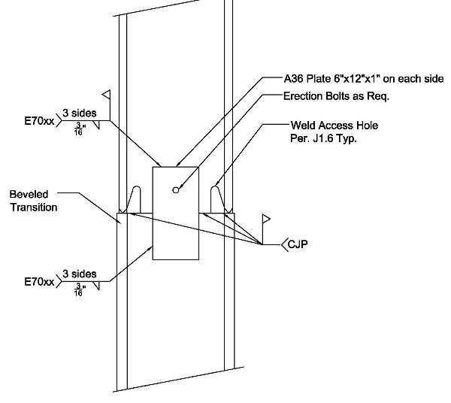
Ingleside AT KING FARM
INTRODUCTION
THESIS STATEMENT
EXISTING CONDITION
BREADTH I
BREADTH II
STRUCTURAL DEPTH
CONCLUSION
a
e
STEPHEN A. TAT
An Architectural Engineering Senior Thesis
Structural Option 2008-2009
Lateral Design
Frame Members:
Columns: W 16x77, W18x119
Beams: W18 x 106
Braces: HSS 9x9x5/8
AISC 341 requires splices be located in the columns to prevent story mechanisms
X-braces are deemed better performers because of the buckling of the braces and excessive beam flexure during an earth quake.
Goals and Criteria
Placement of Expansion Joints
Expansion Joints Specified by Code
Floor System Design
Lateral Design
Seismic Analysis
CR: 141.8, 2954
Introduction
Thesis Statement
CM: 140.27, 29.18
Existing Condition
Breadth Study I
Breadth Study II
Structural Depth
Conclusion
Center of Mass for SCBF
Story | X Direction | Y Direction
Roof | 140.05 | 23.19
7 | 140.05 | 23.19
6 | 140.78 | 29.18
5 | 140.78 | 29.18
4 | 140.78 | 29.18
3 | 140.78 | 29.18
2 | 140.78 | 29.18
Center of Rigidity for SCBF
Story | X Direction | Y Direction
Roof | 142.67 | 29.73
7 | 142.67 | 29.73
6 | 141.8 | 29.5
5 | 141.8 | 29.5
4 | 141.8 | 29.5
3 | 141.8 | 29.5
2 | 141.8 | 29.5
Redundancy Factor ρ = 1.3
Use Equivalent Lateral Force Procedure.
N-S Direction
E-W Direction

Slide 32
Ingleside AT KING FARM
INTRODUCTION
THESIS STATEMENT
EXISTING CONDITION
BREADTH I
BREADTH II
STRUCTURAL DEPTH
CONCLUSION
a
e
STEPHEN A. TAT
An Architectural Engineering Senior Thesis
Structural Option 2008-2009
Lateral Design
Goals and Criteria
Placement of Expansion Joints
Expansion Joints Specified by Code
Floor System Design
Lateral Design
Seismic Analysis
After the earthquake of Northridge 1994, it was discovered that steel moment frame buildings experience brittle fractures of beam-to-column connections. It had demonstrated that brittle fractures was initiated within connections at very low levels of plastic demand and also while the structures remained elastic.
Due to this event, FEMA 350 prequalified several connection types. One is the welded flange plate (WFP), the other being a reduced beam section (RBS).
The RBS connection utilizes less material, and thus is the preferred choice in the prototype design of Ingleside at King Farm. RBS also has no reinforcing other than the weld metal is used to joint the flanges of the beam to the column. This is so that plastic hinges will form at these reduced section areas of the beam. The formation of plastic hinges at the beam-column interface during seismic event results in large inelastic strain demands at the connection leading to brittle failure. The reduced section of the beam at the desired location of the plastic hinge can remedy this issue.
Introduction
Thesis Statement
Existing Condition
Breadth Study I
Breadth Study II
Structural Depth
Conclusion

Slide 33
Ingleside AT KING FARM
INTRODUCTION
THESIS STATEMENT
EXISTING CONDITION
BREADTH I
BREADTH II
STRUCTURAL DEPTH
CONCLUSION
a
e
STEPHEN A. TAT
An Architectural Engineering Senior Thesis
Structural Option 2008-2009
Seismic Analysis
Goals and Criteria
Placement of Expansion Joints
Expansion Joints Specified by Code
Floor System Design
Lateral Design
Seismic Analysis
Drift and Displacement Calculations for SCBF N-S Direction
Story | Height (Ft.) | Story Displacement (in) | δxe (in) | δx (in) | Δa (in) | Final Results
Roof | 12 | 0.684 | 0.104 | 0.475 | 2.880 | ok
7 | 12 | 0.580 | 0.117 | 0.534 | 2.880 | ok
6 | 10 | 0.463 | 0.101 | 0.461 | 2.400 | ok
5 | 10 | 0.362 | 0.101 | 0.461 | 2.400 | ok
4 | 10 | 0.261 | 0.096 | 0.438 | 2.400 | ok
3 | 10 | 0.165 | 0.084 | 0.384 | 2.400 | ok
2 | 14 | 0.081 | 0.081 | 0.370 | 3.360 | ok
Introduction
Thesis Statement
Existing Condition
Breadth Study I
Soft Story Check for SCBF N-S Direction
Story Drift | Drift Ratio | 0.7x the Story Drift Ratio | 0.8x the Story Drift Ratio | Avg. Story Drift Ratio of Next 3 Stories | Soft Story Issue
0.104 | 0.0087 | 0.0061 | 0.0069 | - | No
0.117 | 0.0097 | 0.0068 | 0.0078 | - | No
0.101 | 0.0101 | 0.0071 | 0.0081 | - | No
0.101 | 0.0101 | 0.0071 | 0.0081 | 0.0095 | No
0.096 | 0.0096 | 0.0067 | 0.0077 | 0.0100 | No
0.084 | 0.0084 | 0.0059 | 0.0067 | 0.0099 | No
0.081 | 0.0058 | 0.0041 | 0.0046 | 0.0094 | No
Breadth Study II
Structural Depth
Conclusion

Slide 34
Ingleside AT KING FARM
INTRODUCTION
THESIS STATEMENT
EXISTING CONDITION
BREADTH I
BREADTH II
STRUCTURAL DEPTH
CONCLUSION
a
e
STEPHEN A. TAT
An Architectural Engineering Senior Thesis
Structural Option 2008-2009
Seismic Analysis
Goals and Criteria
Placement of Expansion Joints
Expansion Joints Specified by Code
Floor System Design
Lateral Design
Seismic Analysis
Introduction
Soft Story Check for SCBF E-W Direction
Story Drift | Drift Ratio | 0.7x the Story Drift Ratio | 0.8x the Story Drift Ratio | Avg. Story Drift Ratio of Next 3 Stories | Soft Story Issue
0.206 | 0.0172 | 0.0120 | 0.0137 | - | No
0.176 | 0.0147 | 0.0103 | 0.0117 | - | No
0.198 | 0.0198 | 0.0139 | 0.0158 | 0.0106 | Yes
0.164 | 0.0164 | 0.0114 | 0.0131 | 0.0172 | No
0.162 | 0.0162 | 0.0113 | 0.0129 | 0.0169 | No
0.150 | 0.0150 | 0.0105 | 0.0120 | 0.0174 | No
0.000 | 0.0000 | 0.0000 | 0.0000 | 0.0158 | No
Drift and Displacement Calculations for SCBF E-W Direction
Story | Height (Ft.) | Story Displacement (in) | δxe (in) | δx (in) | Δa (in) | Final Results
Roof | 12 | 1.055 | 0.206 | 0.988 | 2.880 | ok
7 | 12 | 0.849 | 0.176 | 0.844 | 2.880 | ok
6 | 10 | 0.673 | 0.198 | 0.950 | 2.400 | ok
5 | 10 | 0.475 | 0.164 | 0.784 | 2.400 | ok
4 | 10 | 0.312 | 0.162 | 0.775 | 2.400 | ok
3 | 10 | 0.150 | 0.150 | 0.719 | 2.400 | ok
2 | 14 | 0.000 | 0.000 | 0.000 | 3.360 | ok
Thesis Statement
Existing Condition
Breadth Study I
Breadth Study II
Structural Depth
Conclusion
Other Checks: Inherent Torsion, Amplification Factor Ao, Accidental Torsion

Slide 35
Ingleside AT KING FARM
INTRODUCTION
THESIS STATEMENT
EXISTING CONDITION
BREADTH I
BREADTH II
STRUCTURAL DEPTH
CONCLUSION
a
e
STEPHEN A. TAT
An Architectural Engineering Senior Thesis
Structural Option 2008-2009
Goals and Criteria
Placement of Expansion Joints
Expansion Joints Specified by Code
Floor System Design
Lateral Design
Seismic Analysis
Introduction
Thesis Statement
Existing Condition
Breadth Study I
Breadth Study II
Structural Depth
Conclusion

Slide 36
Ingleside AT KING FARM
INTRODUCTION
THESIS STATEMENT
EXISTING CONDITION
BREADTH I
BREADTH II
STRUCTURAL DEPTH
CONCLUSION
a
e
STEPHEN A. TAT
An Architectural Engineering Senior Thesis
Structural Option 2008-2009
Width of Seismic Analysis
Goals and Criteria
Placement of Expansion Joints
Expansion Joints Specified by Code
Floor System Design
Lateral Design
Seismic Analysis
Drift and Displacement Calculations for SCBF E-W Direction For Section 1
Story | Story Displacement (in)
Roof | 1.055
7 | 0.849
6 | 0.673
5 | 0.475
4 | 0.312
3 | 0.150
2 | 0.000
Drift and Displacement Calculations for SCBF E-W Direction For section 2
Story | Story Displacement (in) | ΔM (in)
Roof | 1.270 | 6.35
7 | 1.090 | 5.45
6 | 0.779 | 3.895
5 | 0.615 | 3.075
4 | 0.459 | 2.295
3 | 0.306 | 1.53
2 | 0.167 | 0.835
Introduction
Thesis Statement
Existing Condition
Breadth Study I
Breadth Study II
Structural Depth
Comparing the story displacements of Building Section 1 and 2, Building Section 2 express a greater displacement of 1.27 inches at the roof level. This results in ΔM = 6.35. Since this value only accounts for section 2, this value must be multiplied by 2 giving ΔM_{overall} = 12.7 inches.
It was concluded that a seismic expansion joint of 2 feet is required for the separation of the two building sections.
Conclusion

Slide 37
Ingleside AT KING FARM
INTRODUCTION
THESIS STATEMENT
EXISTING CONDITION
BREADTH I
BREADTH II
STRUCTURAL DEPTH
CONCLUSION
a
e
STEPHEN A. TAT
An Architectural Engineering Senior Thesis
Structural Option 2008-2009
Structural Systems Comparison
Although the prototype system cost almost twice the amount of the existing system, its building structural weight is reduced by about 50%.
The prototype system will require 8 inches of extra ceiling height due to the depth of the girders, resulting in an increase of approximately 5 feet in the overall building height. The decrease in building weight can reduce the base shear of the building during a seismic event, which can help reduce the amount of damage received by the building.
Concrete material is replaced with steel, which results in less material usage and less waste. As post-tension is not a common practice on the west coast, labor cost may be more expensive. The new prototype system is the better choice for its location in Los Angeles, California.
Structural Systems Comparison
 | Existing System: Two-way Flat Plate Post Tension | Prototype System: Composite Steel
Cost | $17.18/sq ft | 29.28/sq ft
Structural Depth | 8" slab | 3 1/2 " slab 18" girder
Structural Weight | 100 psf | 54 psf
Fireproofing | 2 hr (spray on) | 2 hr
Effect of Column Grid | Must Re-align | -
Construction Difficulty | Difficult (West Coast) | Easy
Lead Time | Short | Long
Introduction
Structural Systems Comparison
Façade Material Comparison
Green Roof Retrofit Comparison
Final Words
Acknowledgements
Questions
Thesis Statement
Existing Condition
Breadth Study I
Breadth Study II
Structural Depth
Conclusion

Slide 38
Ingleside AT KING FARM
INTRODUCTION
THESIS STATEMENT
EXISTING CONDITION
BREADTH I
BREADTH II
STRUCTURAL DEPTH
CONCLUSION
a
e
STEPHEN A. TAT
An Architectural Engineering Senior Thesis
Structural Option 2008-2009
Façade Material Comparison:
AAC is cheaper and provides speedy construction and a reduced labor cost. AAC consumes 50% to 20@ less energy than that needed to produce concrete and CMUs. Its thermal efficiency can significantly reduce the cooling loads for the building to comply with California energy conservation codes.
There is also no construction waste as the material is 100% recyclable. Its usage can also reduce the building weight compared with the brick veneer, and reduce the number of façade interfaces of the existing design to reduce the chances of moisture penetration and infiltration. AAC’s high URL fire rating can also help prevent seismic fire related damage. The use of the AAC panels does result in an increase in the thickness of the exterior walls up to 3 inches, but it will deliver a better building envelope performance resulting in energy cost savings, and a worthy investment for a building in a high seismic zone. Another disadvantage would be the cost of anchoring connections
Introduction
Structural Systems Comparison
Façade Material Comparison
Green Roof Retrofit Comparison
Final Words
Acknowledgements
Questions
Facade Material Comparison
 | Existing System: Face Brick Veneer | Prototype System: 6" Autoclaved Aerated Concrete Panels
Material Cost | $2.75/sq foot | $2.30/sq foot
R-Value | 0.8/ inch | 1.25/ inch
Thickness | 4" | 6"
Structural Weight | 38.7 psf | 17 psf
Fireproofing | 1.25 hr | 4 hr
Construction Difficulty | Medium | Easy
Thesis Statement
Existing Condition
Breadth Study I
Breadth Study II
Structural Depth
Conclusion

Slide 39
Ingleside AT KING FARM
INTRODUCTION
THESIS STATEMENT
EXISTING CONDITION
BREADTH I
BREADTH II
STRUCTURAL DEPTH
CONCLUSION
a
e
STEPHEN A. TAT
An Architectural Engineering Senior Thesis
Structural Option 2008-2009
Green Roof Retrofit Comparison:
The usage of an extensive green roof can contribute to the reduction of cooling loads and thus energy consumption and cost by the building. In a life cycle cost analysis, it can increase the service life of the roof membrane, and can help increase the revenue of the residential building.
Environmental improvements includes improved water and air quality, which is an emerging issue in Los Angeles due to traffic and air pollutions. It can also reduce reflection and transmission of heat and glare to surrounding buildings, and mitigate urban heat-island effects. It can be used to control storm water runoff and improve the aesthetic environment. Although the initial cost at first may be expensive, it will pay off in a least two years mainly from revenues and the reduction of mechanical loads. With such a vast roof surface area, Ingleside and King Farm can significantly benefit from the implementing a green roof system. Its extra dead load bears no burden to the structural system as demonstrated in the design calculations.
Roof Retrofit Comparison
 | Existing System: PVC Single Ply System | Prototype System: Green Roof Retrofit
Cost | $ 3.75/sq ft | 15$/sq ft
R-Value | 10.75 | 23.4
Structural Weight | 40 psf | 50 psf
Reflectivity | 95% | -
Emittance | 80% | -
Solar Reflectance index | 110 | -
Average Survice Life | 9.5 | 50
Maintenance | Medium to High | Low
Introduction
Structural Systems Comparison
Façade Material Comparison
Green Roof Retrofit Comparison
Final Words
Acknowledgements
Questions
Thesis Statement
Existing Condition
Breadth Study I
Breadth Study II
Structural Depth
Conclusion

Slide 40
Ingleside AT KING FARM
INTRODUCTION
THESIS STATEMENT
EXISTING CONDITION
BREADTH I
BREADTH II
STRUCTURAL DEPTH
CONCLUSION
a
e
STEPHEN A. TAT
An Architectural Engineering Senior Thesis
Structural Option 2008-2009
Final Works:
Redesigning a prototype design of Ingleside at King Farm for Los Angeles, California will be costly due to the special requirements by codes to make the building safer during and right after a seismic event.
Indirect damage includes fires caused by seismic activity, which can weaken the structural system and cause structural failures. In the case of extremely high seismic activity, such as the Northridge Earthquake in 1994 due to a combination of direct shear and poor soil conditions, retrofitting the building design and to resist seismicity can result in significant savings due to decrease in damages and delayed building functions, and more importantly, increasing the safety and survival rate of the occupants.
Better performance always comes with a cost, however there are paybacks that out weights the dollar amount.
In the case of retrofitting a building for seismic resistance, the reward could be the reduction in lives lost, medical costs, loss of tenants, loss of assets within the building, and loss of building functions.
Other benefits include reduction in insurance premiums, increase in property value, and higher income from tenants.
Introduction
Structural Systems Comparison
Façade Material Comparison
Green Roof Retrofit Comparison
Final Words
Acknowledgements
Questions
Thesis Statement
Existing Condition
Breadth Study I
Breadth Study II
Structural Depth
Conclusion

Slide 41
Ingleside AT KING FARM
INTRODUCTION
THESIS STATEMENT
EXISTING CONDITION
BREADTH I
BREADTH II
STRUCTURAL DEPTH
CONCLUSION
a
e
STEPHEN A. TAT
An Architectural Engineering Senior Thesis
Structural Option 2008-2009
Acknowledgements:
Acknowledgements
I would like to acknowledge and thank the following individuals, design professionals, and firms for their help in making this thesis study possible.
Jeffrey Powell Company
Mr. Jeffrey Powell
Turner Construction Company
Mr. Gary Thompson
Turner-Konover
Mr. Tom Kobylenski
Joseph Potwatts
Introduction
Structural Systems Comparison
Façade Material Comparison
Green Roof Retrofit Comparison
Final Words
Acknowledgements
Questions
The Pennsylvania State University
Dr. Kevin Parfitt
Professor Robert Holland
Colleagues
Daniel Donecker
Ryan Solnosky
Scott Rabold
Alisa Rabold
Mike Spear
Joseph Podwatts
Thesis Statement
Existing Condition
Breadth Study I
Breadth Study II
Structural Depth
Conclusion

Slide 42
Ingleside AT KING FARM
INTRODUCTION
THESIS STATEMENT
EXISTING CONDITION
BREADTH I
BREADTH II
STRUCTURAL DEPTH
CONCLUSION
a
e
STEPHEN A. TAT
An Architectural Engineering Senior Thesis
Structural Option 2008-2009
Thank you…
Questions?
Introduction
Structural Systems Comparison
Façade Material Comparison
Green Roof Retrofit Comparison
Final Words
Acknowledgements
Questions
Thesis Statement
Existing Condition
Breadth Study I
Breadth Study II
Structural Depth
Conclusion

